Slide 1
Asterids
(Sympetalae= flowers with fused petals)
Judd et al. pp. 465-549

Slide 2
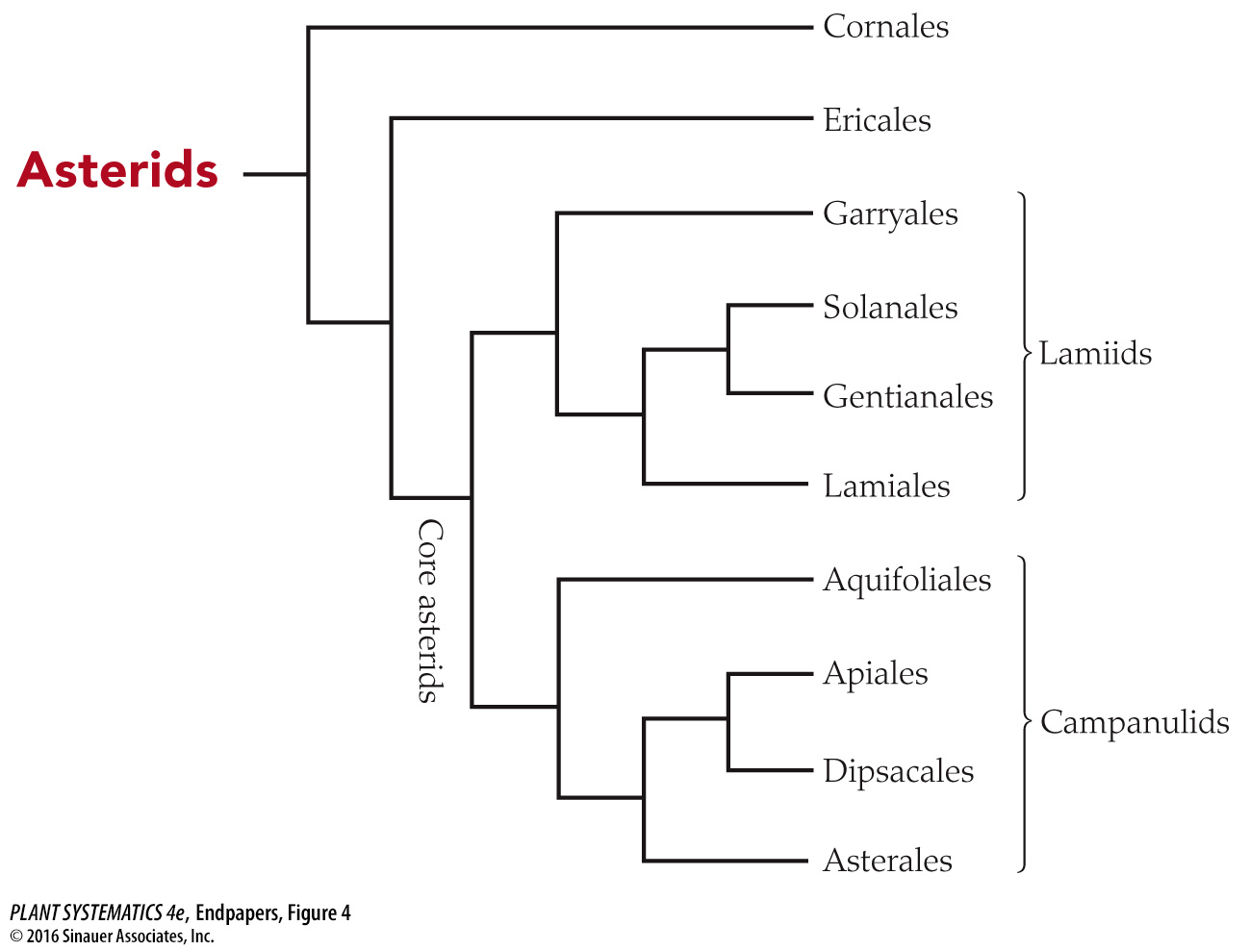
Phylogenetic Relationships within Asterids

Slide 3
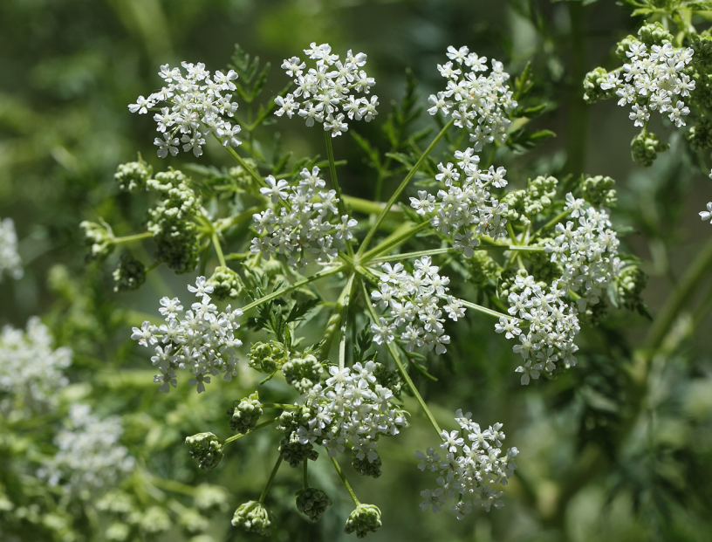
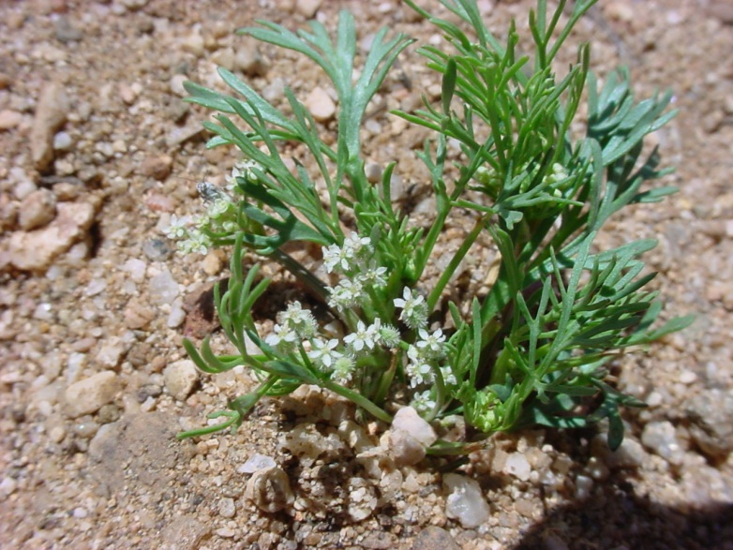
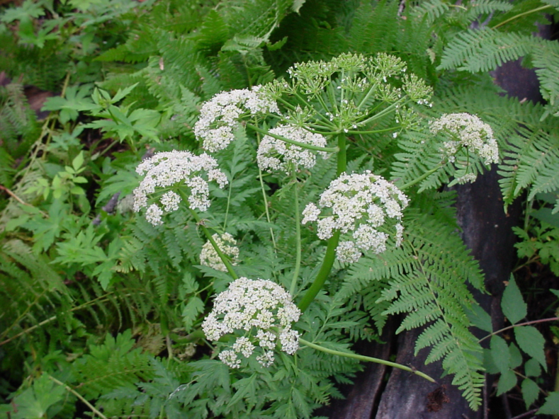
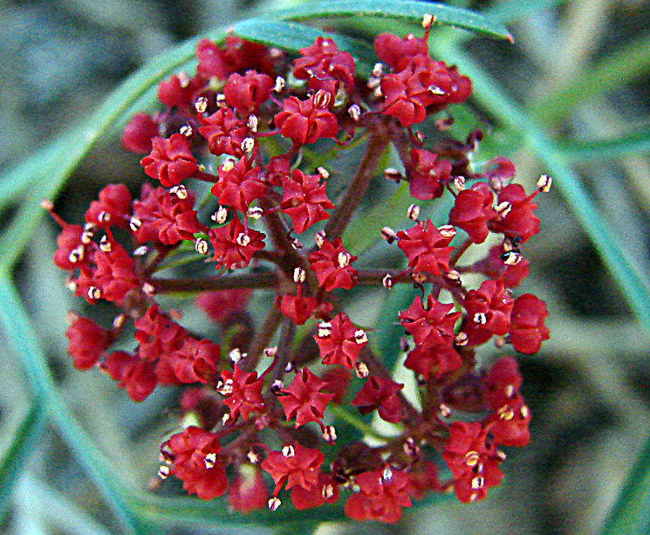
Eudicots: Asterids: Campanulids: Apiaceae:
a.k.a. Umbelliferae
Conium maculatum
Daucus pusillus
See the umbels?
Ligusticum porteri
Cymopterus lemmonii

Slide 4
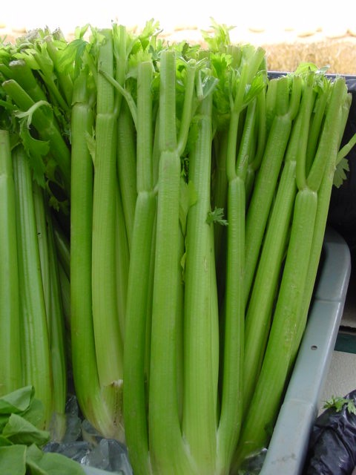
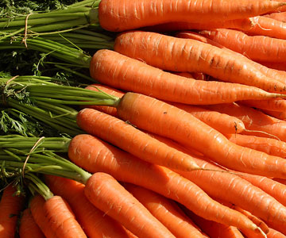
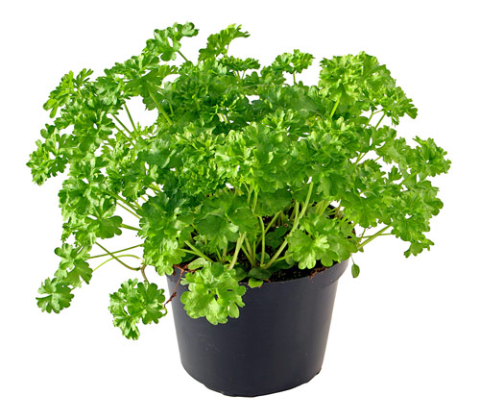
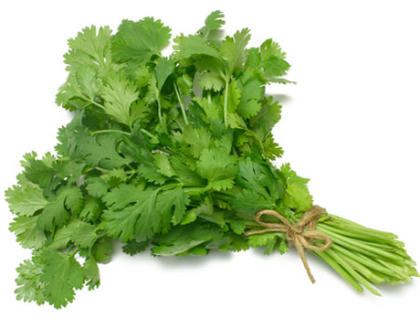
APIACEAE: Food
Apium
Daucus

Slide 5
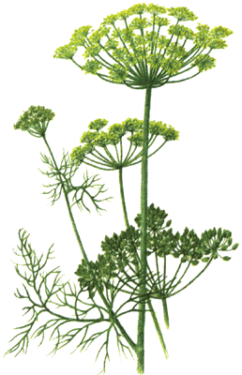
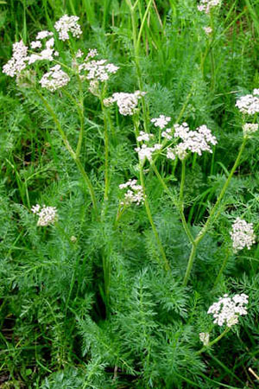
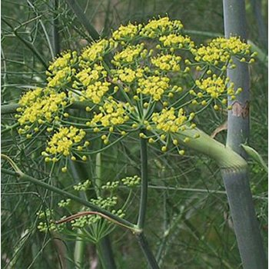
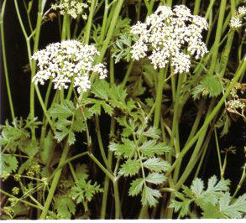
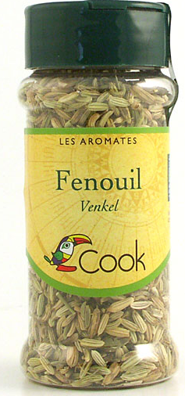
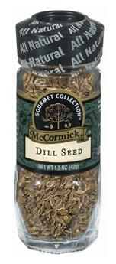
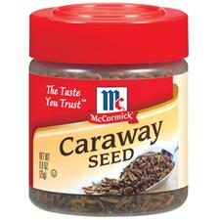
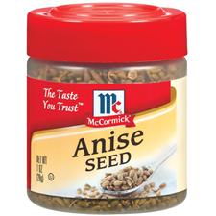
APIACEAE
Foeniculum
Pimpinella
Carum
Anethum

Slide 6
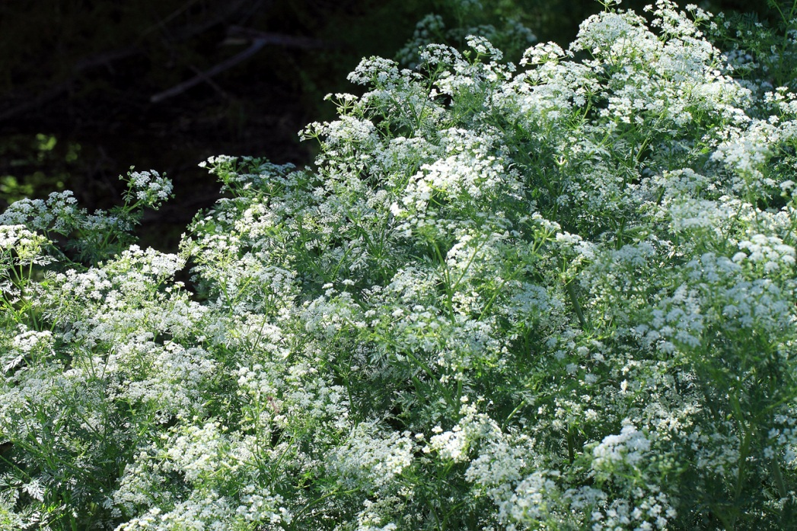
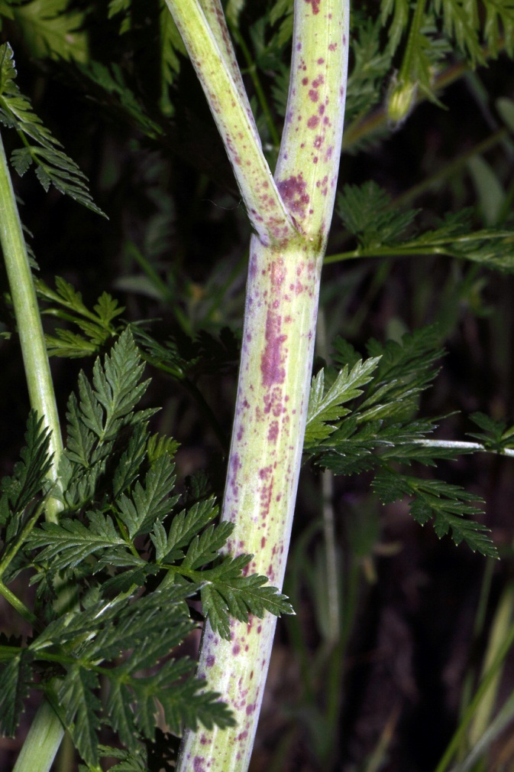
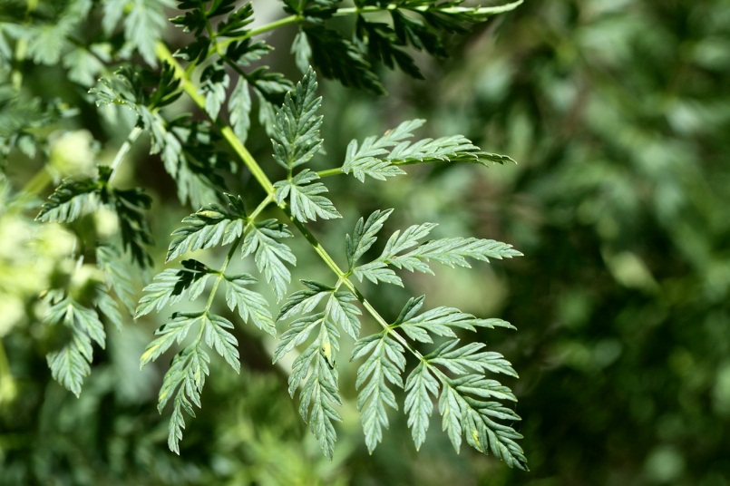
Apiaceae: Can be Poisonous– Conium maculatum (Water Hemlock)

Slide 7

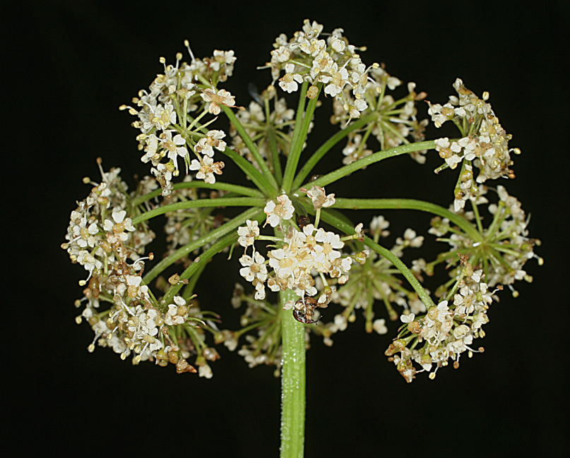
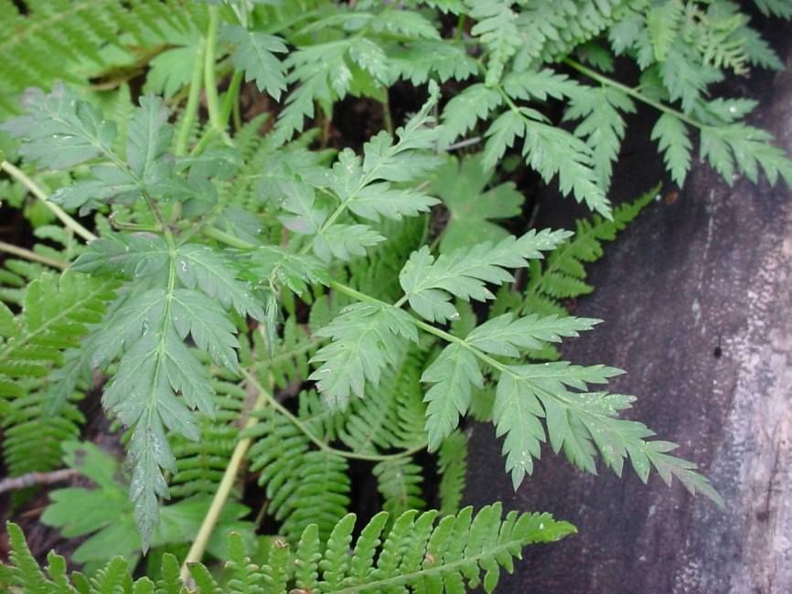
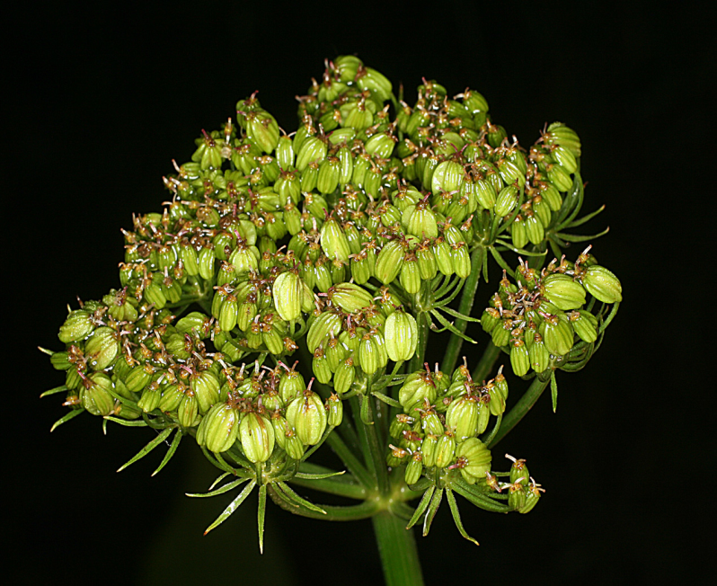
Eudicots: Asterids: Campanulids: Ligusticum porteri
A compound umbel is an umbel of umbels.
Pinnately compound leaf
2 connate carpels in an inferior ovary produce a schizocarp with 2 mericarps.

Slide 8
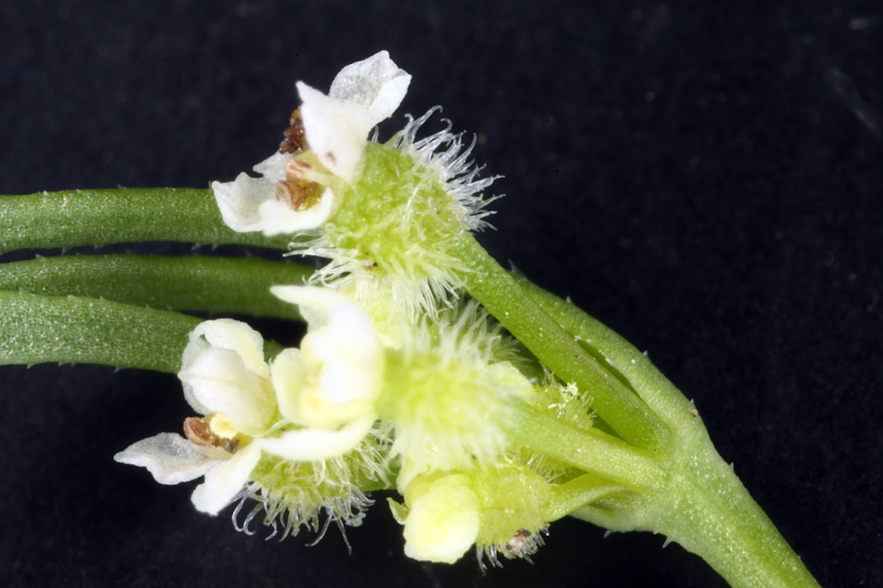
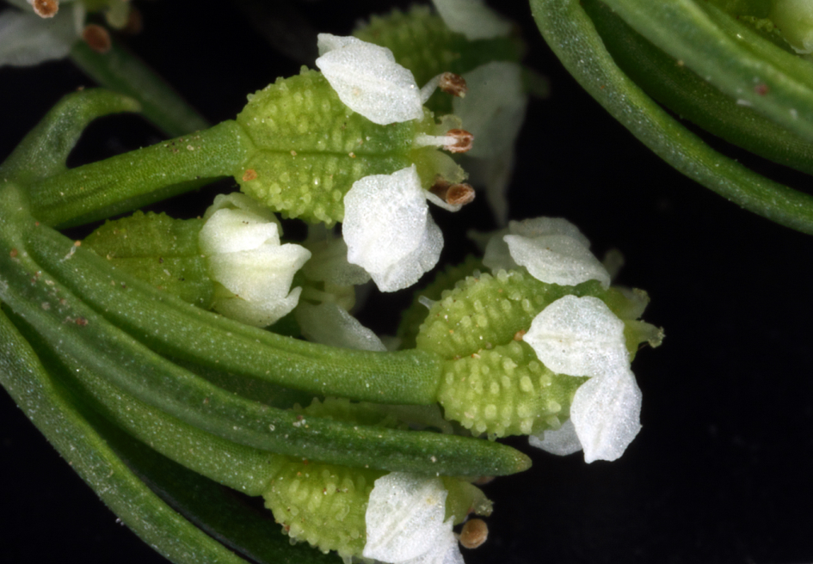
Eudicots: Asterids: Campanulids: Apiaceae
Daucus pusillus: inferior ovary
Spermolepis divaricata: inferior ovary
Perianth insertion is epigynous

Slide 9
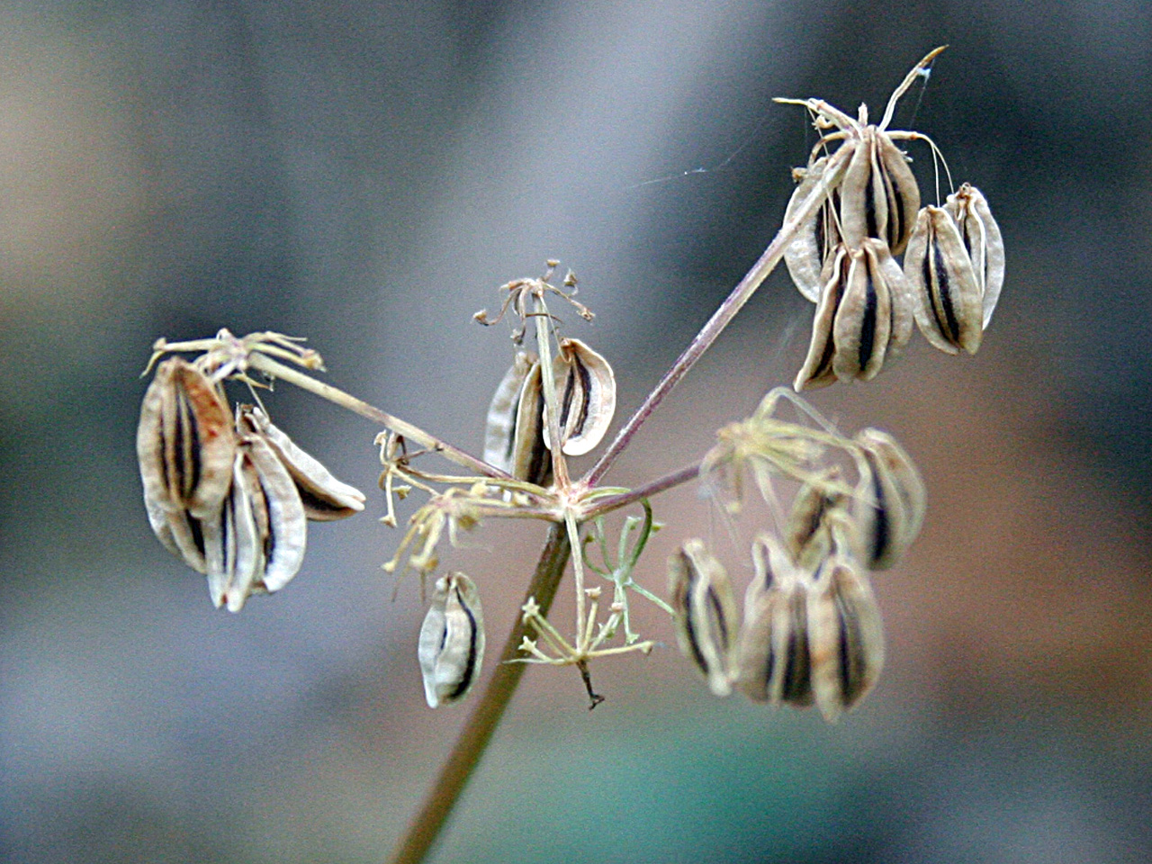
Eudicots: Asterids: Campanulids: Apiaceae (fruit)
Schizocarp with 2 mericarps
Cymopterus lemmonii

Slide 10
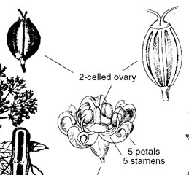
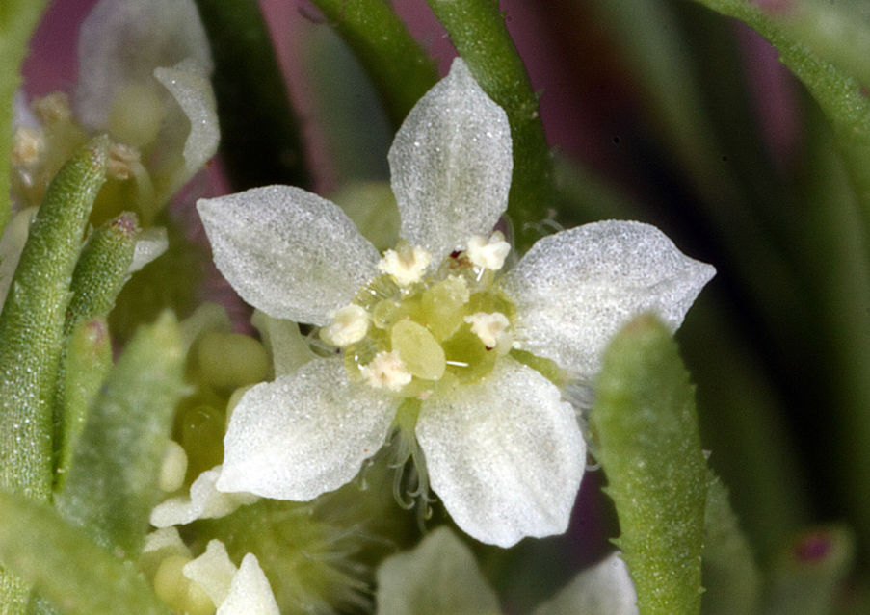
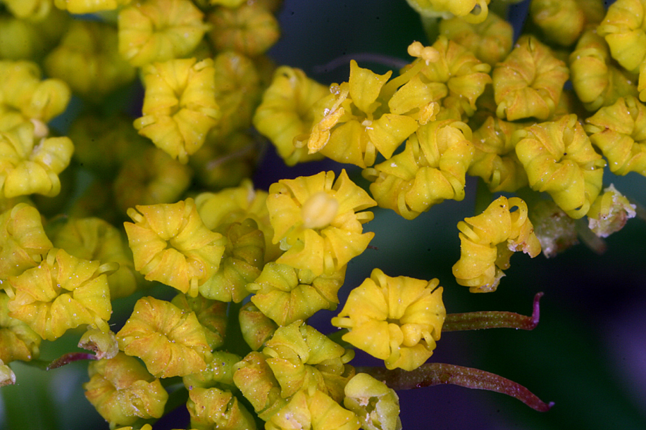
APIACEAE: Flower
Daucus pusillus
Cymopterus lemmonii

Slide 11
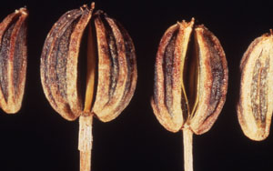
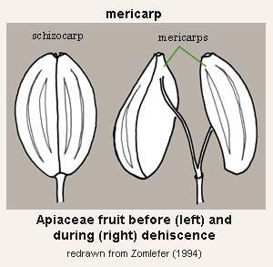
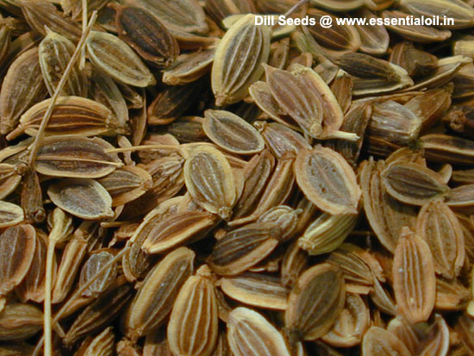
APIACEAE: Fruit

Slide 12
Eudicots: Asterids: Campanulids: Apiaceae
Foliage–
Calyx–
Corolla–
Androecium–
Gynoecium–
Fruit–
usually compound; pinnately compound in Ligusticum
5 distinct but reduced sepals
5 distinct, frequently inflexed
Inflorescence an umbel
5 distinct stamens
2 connate carpels, ovary inferior
schizocarp with 2 mericarps

Slide 13
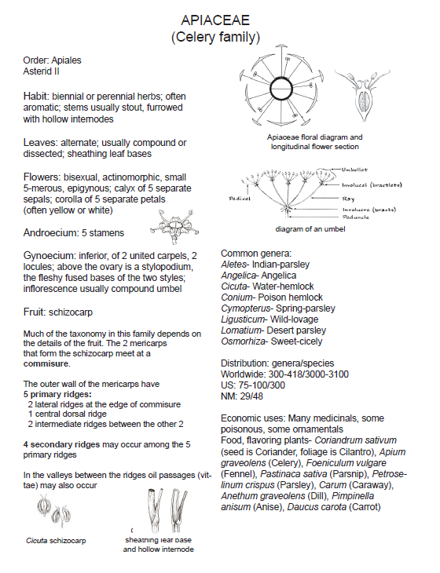

Slide 14
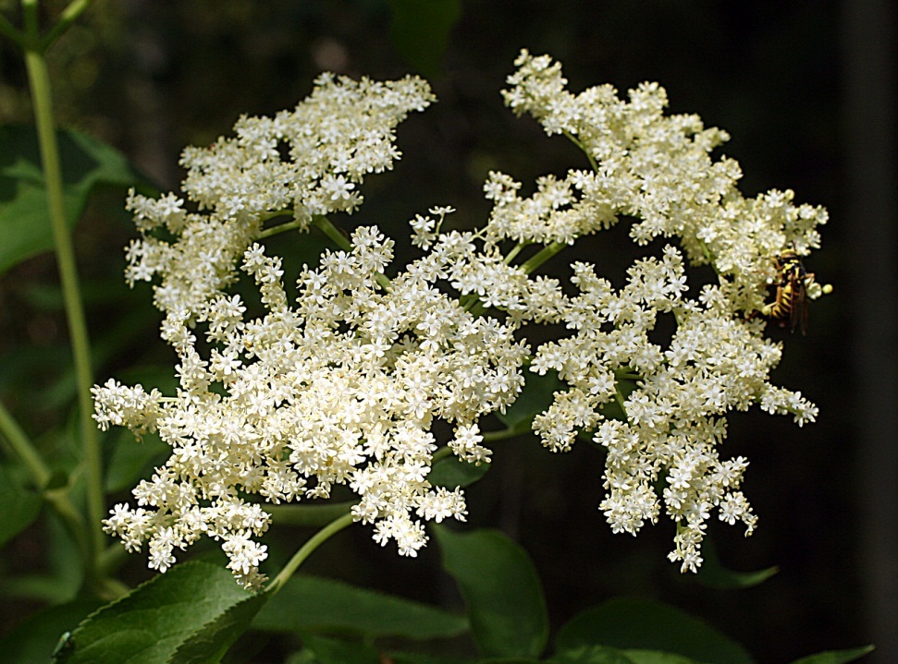
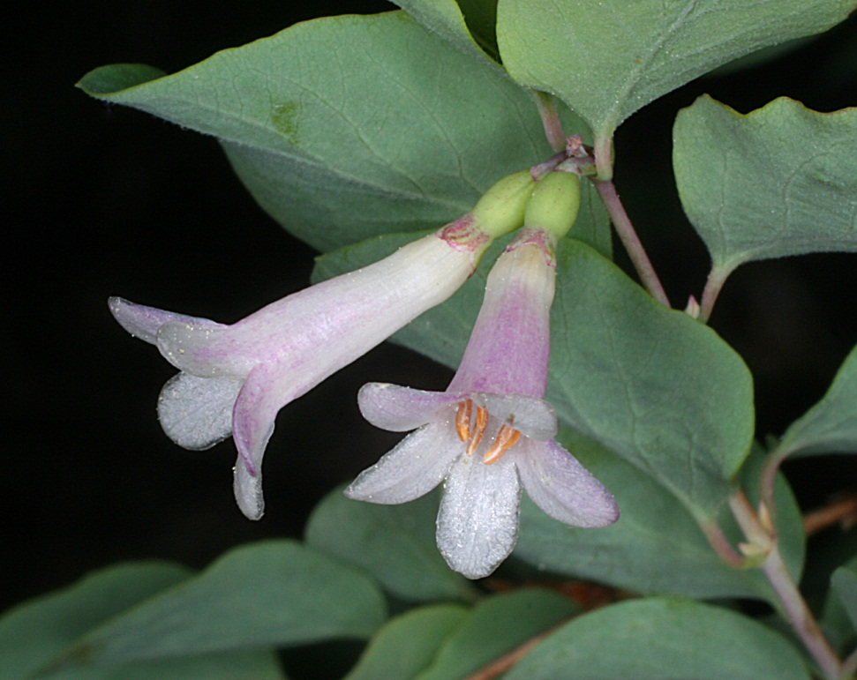
Eudicots: Asterids: Campanulids: Dipsacales
Adoxaceae: Sambucus coerulea var. neomexicana
Caprifoliaceae: Symphoricarpos rotundifolius
Flowers radially symmetric, style short

Slide 15
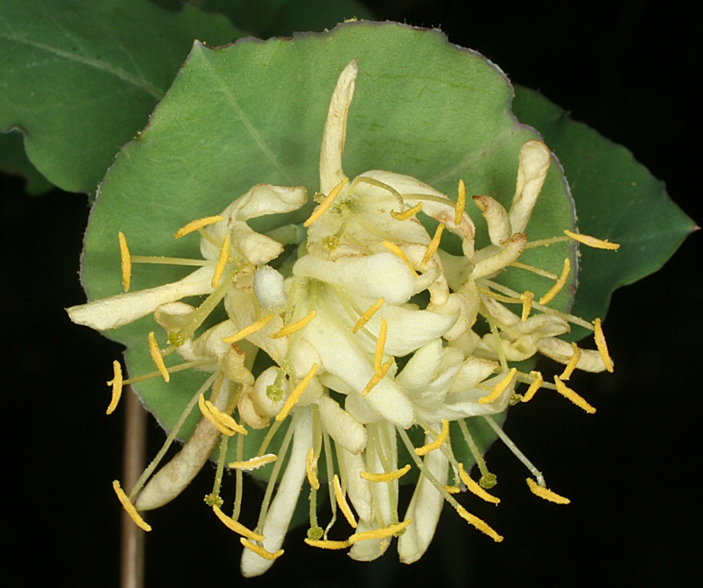
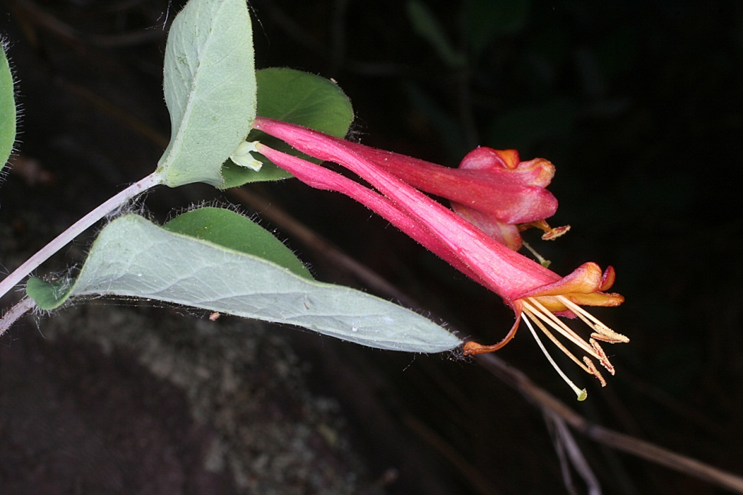
Eudicots: Asterids: Campanulids: Dipsacales
Caprifoliaceae: Lonicera albiflora
Caprifoliaceae: Lonicera arizonica
Flowers zygomorphic; style elongate

Slide 16
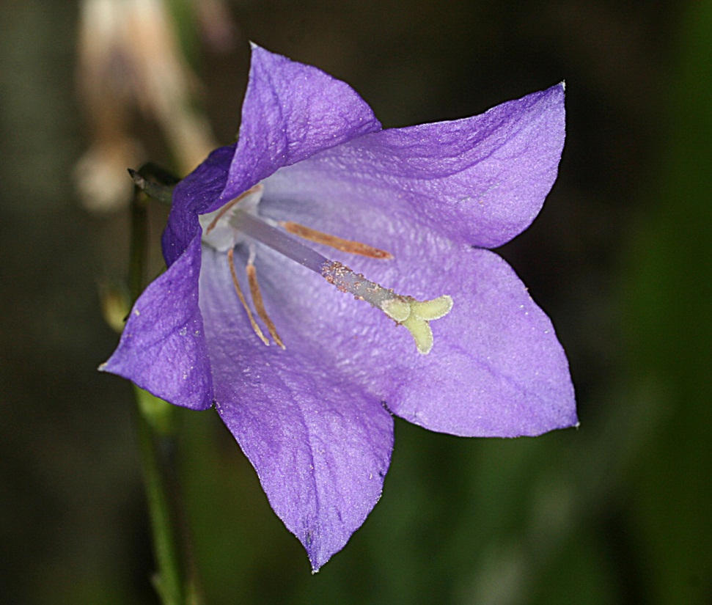
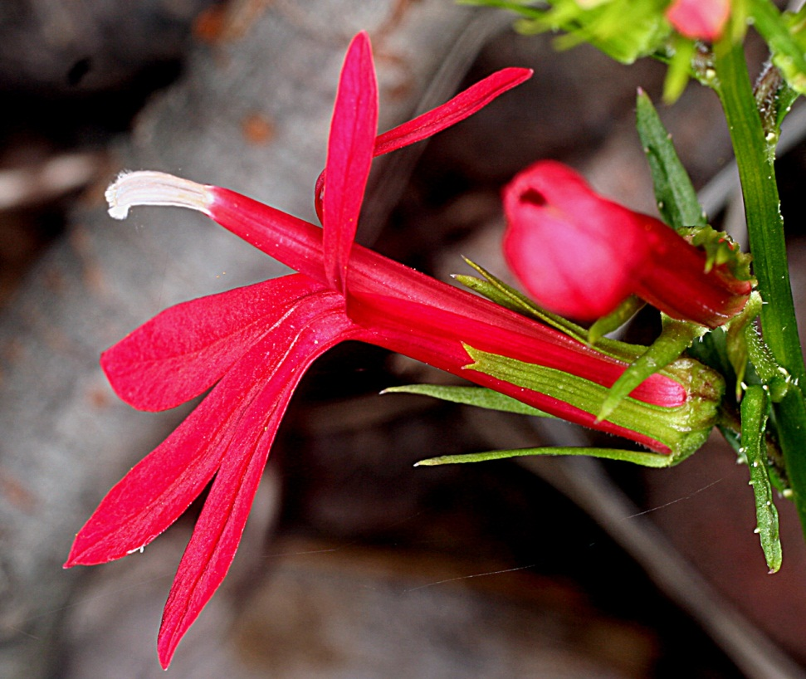
Eudicots: Asterids: Campanulids: Asterales: Campanulaceae
Campanula rotundifolia
Lobelia cardinalis

Slide 17
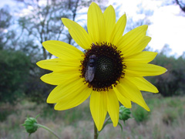
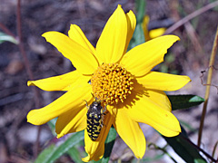
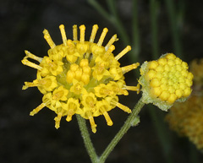
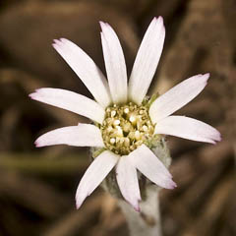
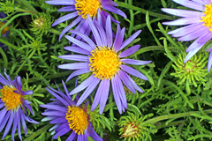
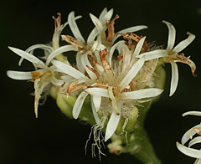
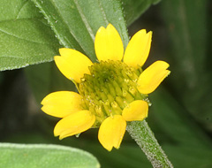
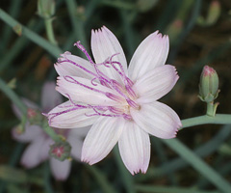
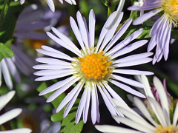
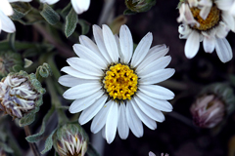
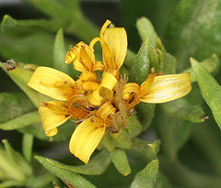

Eudicots: Asterids: Campanulids: Asterales: Asteraceae

Slide 18

Sanvitalia abertii
50-100 flowers here!

Slide 19
Eudicots: Campanulids: Asteraceae
Largest family certainly in North America
24000-30000 species worldwide
They appear to have radiated first from South America! See Funk et al., 2009.

Slide 20


Asterids: Campanulids: Asteraceae
Primarily a styptic and febrifuge; cold tea used for chills and ague; hot tea used to induce sweating and break fevers; also used as a stomachic or carminative for nausea, poor digestion and sometimes as a mild laxative; tea mixed with field mint or poleo (Mentha arvensis) for dizziness and biliousness; dry herbal tea also helps control abnormal menstrual bleeding; a long herbal tradition in Europe dates back to the Trojan War (c.1200 BC); plant named for Greek hero Achilles who supposedly used yarrow to treat soldier's wounds and stop bleeding; dried stems used to consult I Ching, and whole plant used medicinally by Chinese at least since Chou Dynasty (1122 BC)

Slide 21
Phylogenetic Relationships within Asterids

Slide 22
Eudicots: Asterids: Campanulids: Asteraceae
Also known as Compositae (old nomenclature)
Sometimes divided into 13-17 tribes +/- :
Cichoriae, Mutisieae, Cynareae, Inuleae, Ambrosineae, Veronieae, Eupatorieae, Astereae, Senecioneae, Anthemideae, Helenieae, Madieae, Heliantheae, etc.
J&C shows 17 tribes on page 512→ for our purposes, know that these tribes exist for Asteraceae but don’t worry about the details

Slide 23




Weeds
Xanthium
Taraxacum
Centaurea

Slide 24



Allergens
Ambrosia

Slide 25



Ambrosia psilostachya

Slide 26





Food
Helianthus (Sunflower)
Lactuca (Lettuce)

Slide 27




Food
Cynara
(Artichoke)
What are you eating here– Phyllaries!!

Slide 28


INFLORESCENCE
(Head = Capitulum)
Thousands of individual flower in here!

Slide 29




Involucre of Bracts
Involucre= series of bracts surrounding inflorescence
(= Involucre of Phyllaries)

Slide 30



Head Types
Radiate
Discoid
Ligulate

Slide 31


Flower Types:
Ray Flowers and Disk Flowers
(= Ligulate Flowers and Tubular Flowers)

Slide 32


Ray Flower
(= Ligulate Flower)
Anthers connate= syngenesious

Slide 33


Flower Types: Disk Flower
(= Tubular Flower)
Note the inferior ovary: 2 connate carpels
Plunger mechanism: pollen is shed into anther tube and pushed out by style

Slide 34

Hymenothrix wislizeni
Note the typical 2 parted style (2 carpels), radiate flowerheads, syngenesious anthers, and plunger mechanism.

Slide 35



Pappus Types (=Modified Calyx)

Slide 36


Asteraceae: Xanthisma gracile (n=2)
Growth habit
Pappus of capillary bristles

Slide 37


Asteraceae: Brickellia eupatorioides
Flowerhead
Pappus of plumose bristles

Slide 38




Asteraceae: Bidens bigelovii
Flowerhead & leaves
Pappus of retrorsely barbed awns

Slide 39


Carpochaete bigelovii
Flowerheads
Achenes with a pappus of purple scales that are clear margined and plumose near the tip

Slide 40


Amauriopsis dissecta
Flowerhead
Achenes that have NO pappus

Slide 41


Taraxacum officinale
All ray flowers= ligulate
Pappus, beaked, capillary bristles

Slide 42


Asteraceae
Fruit

Slide 43
Eudicots: Asterids: Campanulids: Asteraceae (disc flower)
Foliage–
Calyx–
Corolla–
Androecium–
Gynoecium–
Fruit–
various
modified into pappus of scales, awns, bristles, etc
5 connate petals forming a tube
anthers connate (syngenesious)
2 connate carpels, inferior
achene crowned by pappus

Slide 44


Slide 45
It teaches you, does Botany,
To know the plants and spotany,
And learn just why
They live or die--
In case you plant or potany.

Slide 46
Congrats!
You made it………..!

